Slide 1

Classification Models and Marketing Applications with R
Notes:
Let’s focus on R application for this class….

Slide 2
MKT 591: Course Roadmap
Review of Quant Market Research
Prediction / Regression
Forecasting
Features & Dimensions
Market Segmentation
Simple Linear Regression
Demand Forecasting
Customer Classification
Factor Analysis
Segmentation Basic
Measurement Scales
Categorical Variables
BASS Diffusion Model
Discriminant Analysis
MDS
Advanced Model-based Segmentation
Discrete Analysis (CrossTab)
Extracting Features by Text Analytics
Multiple Regression
Bayesian Classifier
Spatial Segmentation
Continuous Analysis (Correlation)
Issues in Regression
Tree Models
Deep Learning
Logistic Regression (Consumer Choice)
Bayesian Statistics

Slide 3
Agenda
Machine learning in Marketing
Linear/Quadratic Discriminant Analysis
(Naïve) Bayesian Classification
Classification and Regression Tree (CART)
Random Forest
We will focus on practical R utilizations for classification methods.

Slide 4
Classification problems in Marketing
Who are the target segment?
Who are the profitable consumers?
Will this person like this movie (for movie recommendation)? (e.g., Netflix)
Others) Spam email? Potential customers who will open the bank account?

Slide 5
Classification Examples in Marketing
Consumer Packaged Goods
Potential Purchasers vs. non-purchasers
Heavy versus light users
Profitable versus non-profitable customers
Financial Industries
Loan applications (potential loan contractors)
Credit card approval
High-tech Industries
Innovators versus imitators

Slide 6
Classification Application Example in Marketing (We are already using this data for your assignment)
Direct Marketing Campaign for Bank Loan in Portugal. (http://archive.ics.uci.edu/ml/datasets/Bank+Marketing)
45211 observations; 17 features.
The classification goal is to predict if the client will subscribe (yes/no) a term deposit (variable y).
Input variables: age; job, marital, education, housing (i.e., has housing loan?), loan (i.e., has personal loan?), communication type (e.g., ‘cellular’ or ‘telephone’), last contact month of year, etc.
Output variable: y – has the client subscribed a term deposit? (‘yes’, ‘no’)

Slide 7
Linear Discriminant Analysis

Slide 8
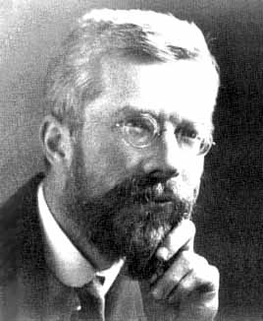
Linear Discriminant Analysis
As a possible example, a predictor (X1) of “practical Business Application” attribute might be able to classify students between the “MSBA” group and the “statistics/engineering” group.
The goal of LDA is to find the discriminant function Z (e.g., a linear combination of the predictors) that leads to an optimal division of the groups.

Slide 9
Assumptions for LDA
Predictor variables are normally distributed (i.e., Multivariate Normal Distribution) – if not, we can consider other methods (e.g., logistic regression).
That is, predictors for LDA should be continuous variables.
Equal variances across groups (This assumption can be relaxed with the Quadratic Discriminant Analysis (QDA)).

Slide 10
Linear Discriminant Analysis and Function
LDA involves deriving the linear combination of the two (or more) independent variables that will discriminate between the a priori defined groups.
The linear combination (known as the discriminant function or axis) takes the following form:
The discriminant weights (b_{i}) are chosen so as to maximize the ratio of the between-group variance relative to the within-group variance
Let’s see how to find the weights/coefficients (b_{i}) in R

Slide 11

Example with R
An IT venture company has a historical data of 60 potential client firms with discrete (binary investment intentions: No=1, Yes=2)
The goal is to classify the potential client firms in terms of investment intentions by using “employee size”, “firm revenue”, “years of operation”, and “number of products”.

Slide 12
Steps in Discriminant Analysis
Run lda in R package “MASS”
Examine the Coefficients of Linear Discriminants
Proportions by sample data
Mean of each X when Z=0 or Z=1
Notes:
Normalization of X… (check it)

Slide 13
LDA Cutoff value Decision for Prediction
Individuals are assigned based on the cutoff value, Z_{cutoff}
The cutoff value for equal group sizes is:
The cutoff value for unequal group sizes is:
Example)
E.g., ‘Low’ represents Z=0; ‘High’ represents Z=1
Notes:
Low: Z=0, High: Z=1
Predict Y using X (Linear combinations of explanatory variables).

Slide 14
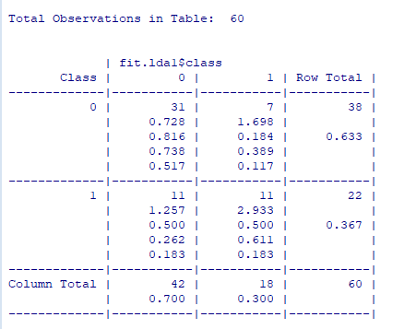
Steps in Discriminant Analysis
Hit rate = 70% (% correctly classified)

Slide 15
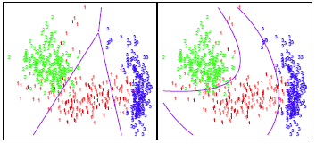
Quadratic Discriminant Analysis
The predictor variables are not assumed as same covariance matrix across groups.
QDA provides a non-linear quadratic decision boundary. Thus, when the decision boundary is moderately non-linear, QDA may give better results. (Let’s do this in R…)

Slide 16
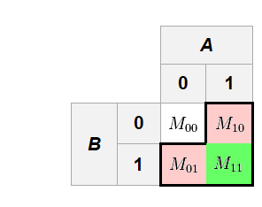
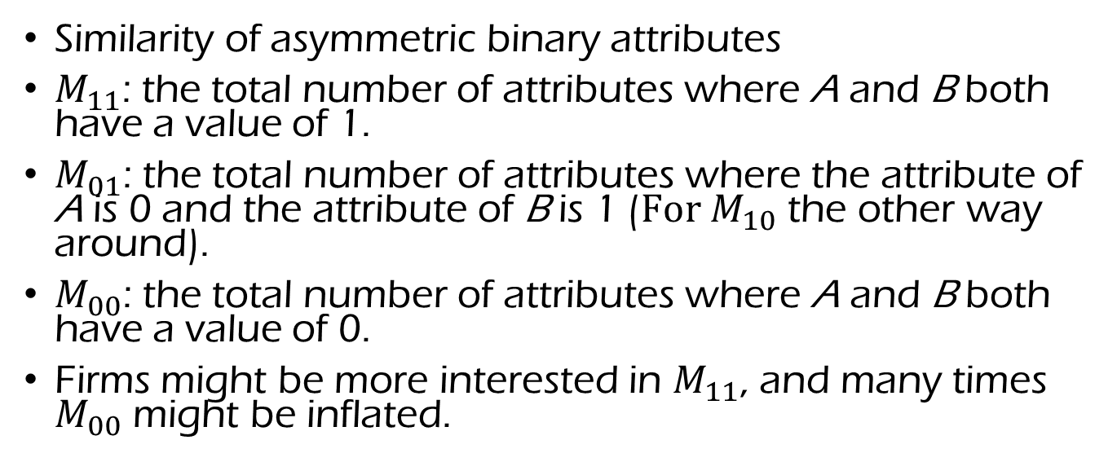
Jaccard Similarity Index
Similarity of asymmetric binary attributes
$M_{11}$: the total number of attributes where A and B both have a value of 1.
$M_{01}$: the total number of attributes where the attribute of A is 0 and the attribute of B is 1 ($For M_{10}$ the other way around).
$M_{00}$: the total number of attributes where A and B both have a value of 0.
Firms might be more interested in $M_{11}$, and many times $M_{00}$ might be inflated.
Please calculate Jaccard Similarity index for the IT Venture Example.
Notes:
M00 过大 干扰 classification的结果测量
M11/(M11+M10+M01)

Slide 17
Managerial Implications
For external (new) firms, they can classify the potential target investor firms and focus on our resources.
Using firmographic information for the target firms, we can develop efficient marketing strategies.
By tracking and updating the supervised information, the model (and parameters) can be improved for future decisions.

Slide 18
(Naïve) Bayesian Classifier
Notes:
Conceptually, Not difficult… but if anyone is not familiar with Bayesian Statistics, it might not be easy. So, I will briefly explain the model, but let’s practice how to utilize this method in R…

Slide 19
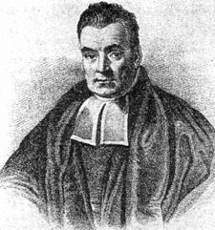
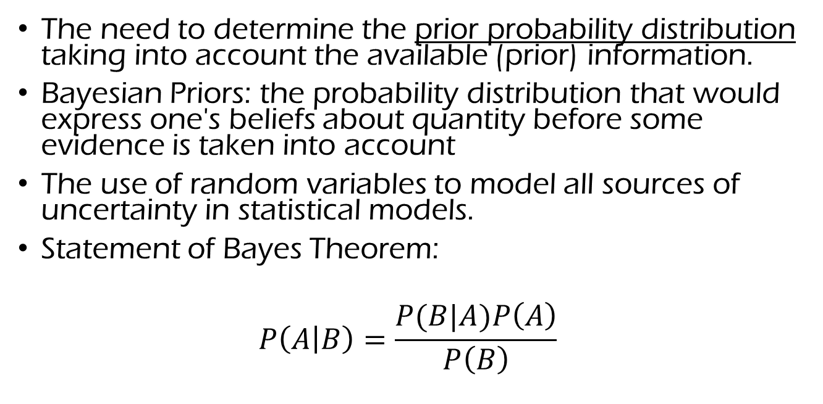
Bayesian methodology
Thomas Bayes
The need to determine the prior probability distribution taking into account the available (prior) information.
Bayesian Priors: the probability distribution that would express one's beliefs about quantity before some evidence is taken into account
The use of random variables to model all sources of uncertainty in statistical models.
Statement of Bayes Theorem:
$$P\left(A | B\right)=\frac{P(B|A)P\left(A\right)}{P\left(B\right)}$$

Slide 20
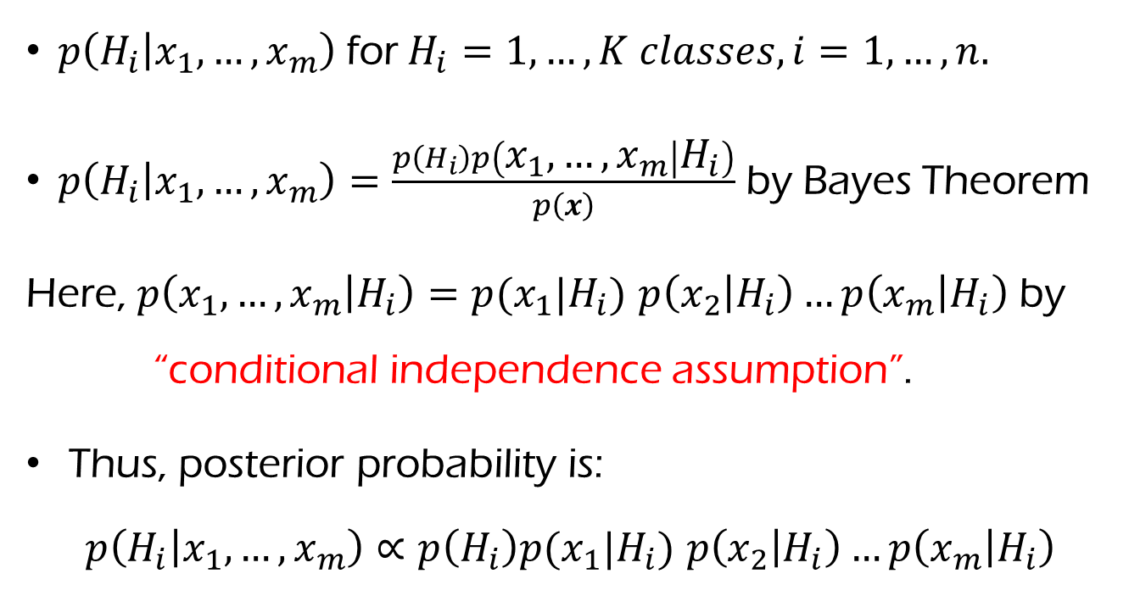
Naïve Bayes Classifier
Let’s skip this!
$p\left(H_{i} | x_{1}, …, x_{m}\right)$for$H_{i}=1,…, K classes, i=1,…,n.$
$p\left(H_{i} | x_{1}, …, x_{m}\right)=\frac{p\left(H_{i}\right)p\left(x_{1}, …, x_{m} | H_{i}\right)}{p\left(x\right)}$ by Bayes Theorem
Here, $p\left(x_{1}, …, x_{m} | H_{i}\right)=p(x_{1}|H_{i})$ $p\left(x_{2} | H_{i}\right)…p\left(x_{m} | H_{i}\right)$ by “conditional independence assumption”.
Thus, posterior probability is:
$$p\left(H_{i} | x_{1}, …, x_{m}\right)∝p\left(H_{i}\right)p(x_{1}|H_{i}) p\left(x_{2} | H_{i}\right)…p\left(x_{m} | H_{i}\right)$$
Maximize this term

Slide 21
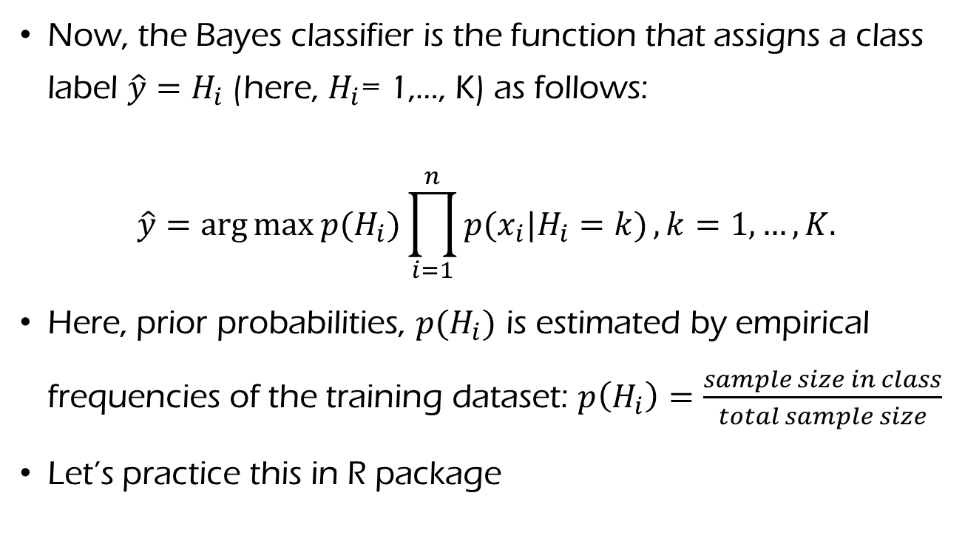
Naïve Bayes Classifier
Let’s skip this!
Now, the Bayes classifier is the function that assigns a class label $\hat{y}=H_{i}$ (here, $H_{i}$= 1,…, K) as follows:
$$\hat{y}=\arg{\max{p(H_{i})\prod_{i=1}^{n}{p(x_{i}|H_{i}=k)}}, k}=1,…, K.$$
Here, prior probabilities, $p(H_{i})$ is estimated by empirical frequencies of the training dataset: $p\left(H_{i}\right)=\frac{sample size in class}{total sample size}$
Let’s practice this in R package

Slide 22
Naïve Bayes Classifier
Let’s skip this!
It uses training data to learn the probability of class membership as a function of each predictor variable considered independently (hence “naive”).
When assumption of independence holds, a Naive Bayes classifier performs better compare to other models like logistic regression and you need less training data. (This independence assumption can be a limitation in real world application…).
This method is easy to build and can be particularly useful for very large data sets (along with simplicity).
For predictors, you can use both continuous and discrete variables : It helps to transform continuous variables to normal distribution.

Slide 23
Bank Marketing Data (Moro et al. 2011) Example with R
Let’s run Naïve Bayes classifier with two predictors of ‘age’ and ‘housing’.
Randomly hold 25% of sample as validation (test) samples for prediction validation purpose.
Predict the validation samples by training samples. What is hit rate?

Slide 24
Sample Results with Age and Housing
What is prediction hit rate? What is problem of prediction hit rate?
What is Jaccard similarity index?
Do you think the prediction works well?

Slide 25
Classification and Regression Tree (CART)
As I heard, CART has been covered in previous classes,
so I would focus on practical analysis with R.

Slide 26
Advantages; Decision Trees
Read it for yourself
Computationally simple and quick to fit, even for large problems.
Automatic variable selection.
Very easy to interpret if the tree is small.
Tree picture provides valuable insights.
Terminal nodes suggest a clustering of data.
(Adele Cutler 2010)

Slide 27
Disadvantages; Decision Trees
Let’s skip this!
Accuracy – relatively lower than other tree methods (e.g., Random forest or Boosting, etc.)
Instability – if changing the data a little, the tree picture can change a lot.
(Adele Cutler 2010)

Slide 28
Classification and Regression Tree (CART)
Let’s skip this!
We denote the feature space by X.
Tree structured classiers are constructed by repeated splits of the space X into smaller and smaller subsets, beginning with X itself.
Definitions: parent node, child node, terminal node (leaf node).
Reference: Classification and Regression Trees by L. Breiman, J. H. Friedman, R. A. Olshen, and C. J. Stone, Chapman & Hall, 1984.

Slide 29
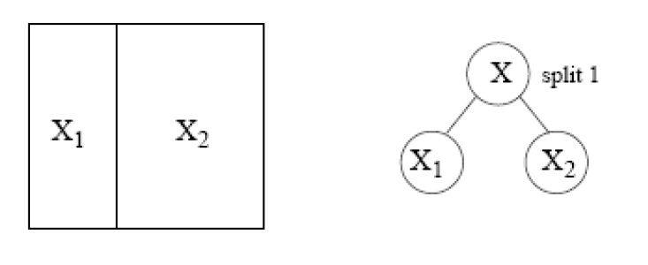
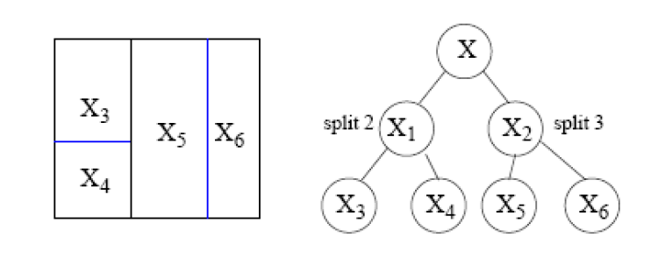
CART Split Procedure (1)
Let’s skip this!
Whose space is represented by X.
It is split into two regions.
Node
Next, the region represented by X1 is split into two.
And then the region represented by X2 is split.

Slide 30
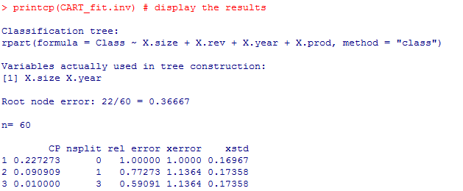
IT venture example
Use set.seed(100)
Variables used in tree constructions
Notes:
CP represents ‘Complexity Parameter’.

Slide 31
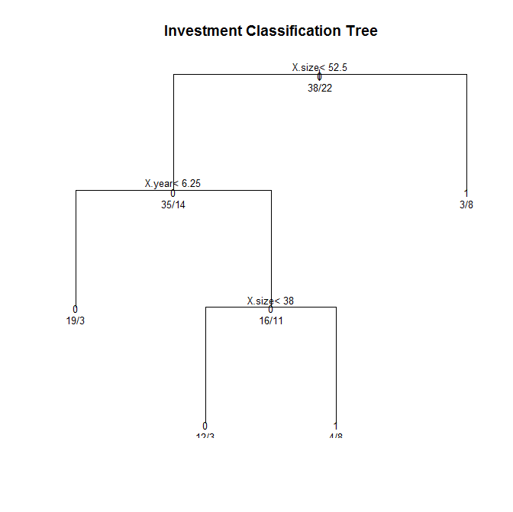

IT venture example
Using rpart in R, apply the tree model on IT venture company data
0 is 38; 1 is 22
(E.g., 49 by X.size<52.5)
0 is 35; 1 is 14
0 is 3; 1 is 8.
Prediction: 78.3% hit
Notes:
35+3=38; 14+8=22
14/22

Slide 32
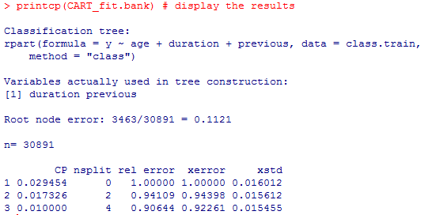
Bank Sample
Use 4 predictors: age, marital, housing, and duration
What is variable which is used in tree construction?
What is prediction hit ratio?
Notes:
89.6%
23%

Slide 33
Criterion for attribute selection
Let’s skip this!
Which is the best attribute?
The one which will result in the smallest tree
Heuristic: choose the attribute that produces the “purest” nodes
Need a good measure of purity!
Maximal when?
Minimal when?

Slide 34
Information Gain (An impurity criteria)
Let’s skip this!
Starting example) Which test is more informative?
Split over whether Balance exceeds 50K
Split over whether applicant is employed
Less or equal 50K
Over 50K
Unemployed
Employed
Reference: http://www.cs.washington.edu
Notes:
Right one is more informative.
Good to review to understand the mechanism of CART

Slide 35
Impurity
Let’s skip this!
Very impure group
Less impure
Minimum
impurity
Reference: http://www.cs.washington.edu

Slide 36
Let’s skip this!
Entropy: a common way to measure impurity
Entropy =
p_{i} is the proportion of class i
Compute it as the proportion of class i in the set.
Entropy comes from information theory. The higher the entropy the more the information content.
Reference: http://www.cs.washington.edu

Slide 37
Let’s skip this!
2-Class Cases:
What is the entropy of a group in which all examples belong to the same class?
entropy = - 1 log₂1 = 0 (Entropy = 0)
What is the entropy of a group with 50% in either class?
entropy = -0.5 log₂0.5 – 0.5 log₂0.5 =1
Minimum
impurity
Maximum
impurity
Reference: http://www.cs.washington.edu

Slide 38
Information Gain
Let’s skip this!
We want to determine which attribute in a given set of training feature vectors is most useful for discriminating between the classes to be learned.
Information gain tells us how important a given attribute of the feature vectors is.
We will use it to decide the ordering of attributes in the nodes of a decision tree.
Reference: http://www.cs.washington.edu

Slide 39
Let’s skip this!
Calculating Information Gain
Information Gain = entropy(parent) – [average entropy(children)]
child
entropy
Entire population (30 instances)
17 instances
child
entropy
parent
entropy
13 instances
(Weighted) Average Entropy of Children =
Information Gain= 0.996 - 0.615 = 0.38
Entropy has been reduced == purity increased!!
Reference: http://www.cs.washington.edu

Slide 40
Random Forest

Slide 41
Random Forest
Relatively good accuracy, robustness (resolving instability issue) and ease of use;
Grow a forest of many trees. (R default is 500) . Grow each tree on an independent bootstrap sample from the training data.
Provides variable importance.

Slide 42
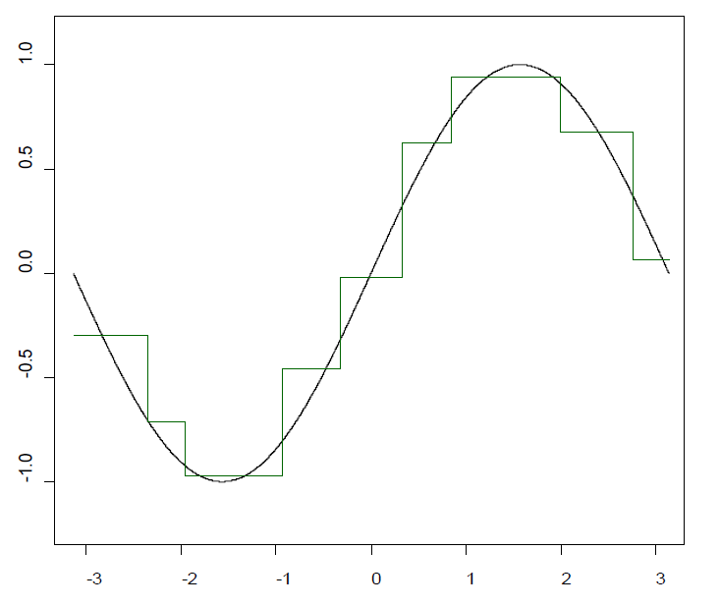
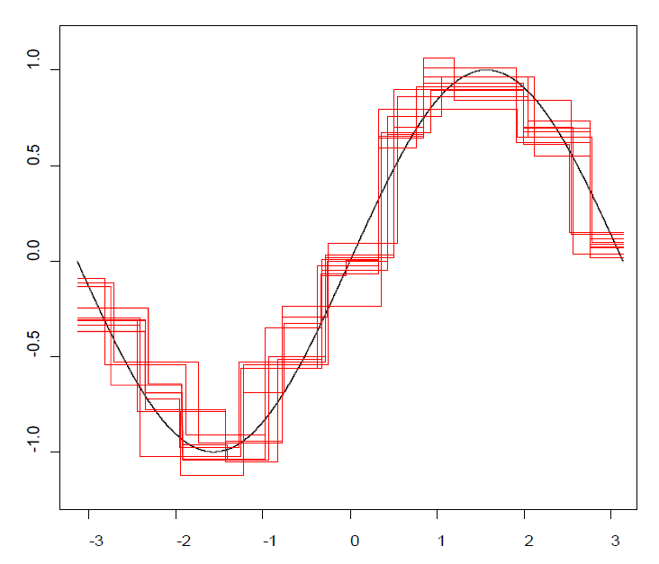
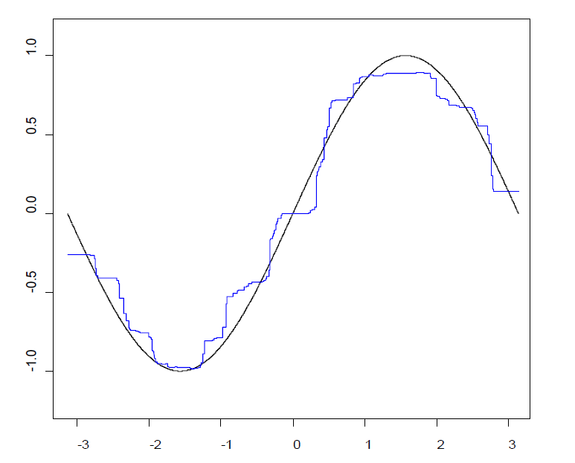
How this works?
Single Tree
(Adele Cutler 2010)
Random Forest
Notes:
To classify a new object from an input vector, put the input vector down each of the trees in the forest. Each tree gives a classification, and we say the tree "votes" for that class. The forest chooses the classification having the most votes (over all the trees in the forest).

Slide 43
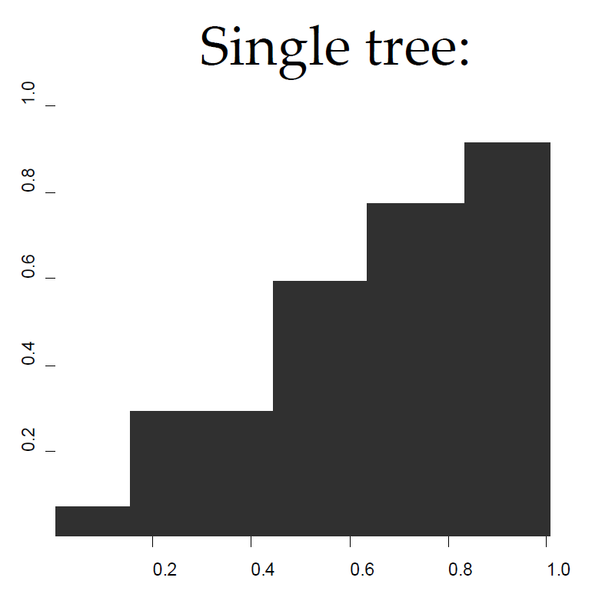
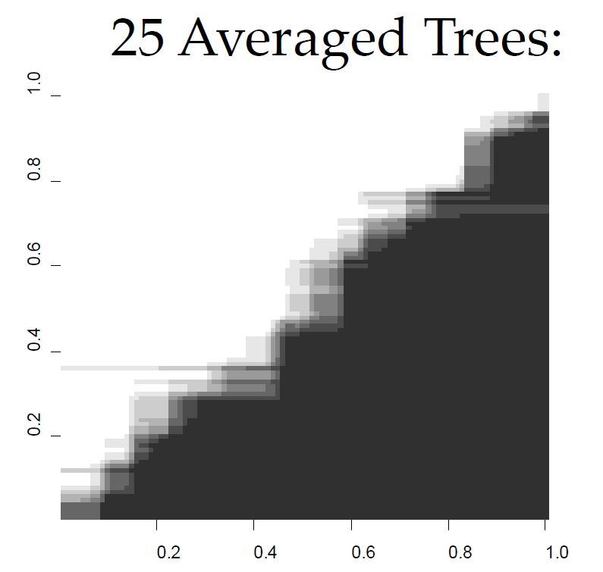
Simulation Examples

Slide 44
Machine Learning
Related to Computer Science and Computational Statistics, and machine learning explores the construction of algorithms that can learn from and make predictions on data.
Not much worry about causal relationship between independent variables and dependent variables, but care how the response variable varies depending on the value of given predictors.
For finding causal relationship (at least, exogenous drivers), we need more careful study design (e.g., randomized [field] experiments), but the learning procedure can be helpful for study design to establish possible causal relationships.
We will discuss more for this in Deep Learning Section

Slide 45

TED Talk (helpful to understand the concept of machine learning)
Kenneth Cukier, Data Editor of The Economist.
The era of Big Data: 1:40 - 6:00
Machine learning Concepts: 7:30-10:30.
Any other your thoughts about future machine learning?

Slide 46
Main Interests of Machine Learning
Usually, we can use cross validation approach to examine the predictive performances: e.g., Training dataset and Validation data set.
Main interests of this learning procedure
Prediction accuracy
Important predictors (i.e., feature selection) in terms of their contribution to the fit or forecast
Variable selection when a very large number of predictors.

Slide 47
Supervised Learning and Unsupervised Learning
Machine learning task of inferring a function from labeled training data.
Classification: inputs are divided into two or more categories, and the learner assigns unseen inputs to one category by using model. This is typically tackled in a supervised way. --- Spam filtering: the inputs are emails and the categories are "spam" and "not spam".
Classification Methods: Decision Trees, Ensembles (Bagging, Boosting, Random Forest), Naïve Bayes, Logistic Regression, Support Vector Machine.

Slide 48
Supervised Learning and Unsupervised Learning
No labels are given to the learning algorithm, leaving it on its own to find structure in its input -- discovering hidden patterns (latent structure) in data (wiki).
Clustering: a set of inputs is to be divided into groups (or segments). Unlike classification, the groups are not known beforehand (i.e., no label information), making this typically an unsupervised task – Searching hidden structure.
Hierarchical Clustering, K-means method, Model-based Clustering, Latent Class Regression, etc.

Slide 49
Bayesian Boosting (BART in R)

Slide 50
Bayesian Boosting
Bayesian Additive Regression Tree (BART) provide flexible nonparameteric modeling of covariates for continuous, binary, categorical and time-to-event outcomes.
Author of this method: https://math.asu.edu/node/2277
Let’s see practical application example in R.

Slide 51
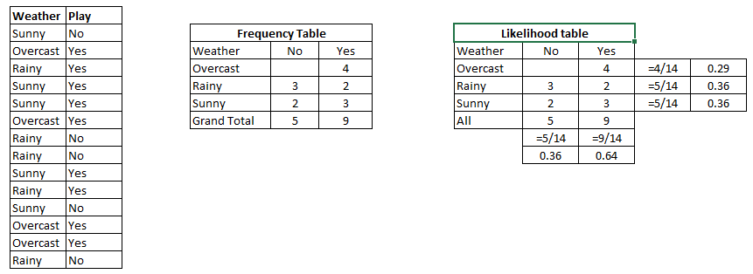
Simple Example to how Bayesian works: Below there is a training data set of weather and corresponding target variable ‘Play (H)’ (suggesting possibilities of playing). Let’s classify whether players will play or not based on weather condition.
Effects of predictors
(e.g., Overcast, Rainy, Sunny)
P(Yes | Sunny) = P( Sunny |Yes) * P(Yes) / P (Sunny)
P (Sunny |Yes) = 3/9 = 0.33; P(Sunny) = 5/14 = 0.36; P(Yes)= 9/14 = 0.64
P (Yes | Sunny) = 0.33 * 0.64 / 0.36 = 0.60
Example Reference: www.AnalyticsVidhya.com (2017)

